Slide 1
Operating System

Slide 2
Memory-Management Unit (MMU)
Hardware device that at run time maps virtual to physical address
Many methods possible, covered in the rest of this chapter
To start, consider simple scheme where the value in the relocation register is added to every address generated by a user process at the time it is sent to memory
Base register now called relocation register
MS-DOS on Intel 80x86 used 4 relocation registers
The user program deals with logical addresses; it never sees the real physical addresses
Execution-time binding occurs when reference is made to location in memory
Logical address bound to physical addresses

Slide 3
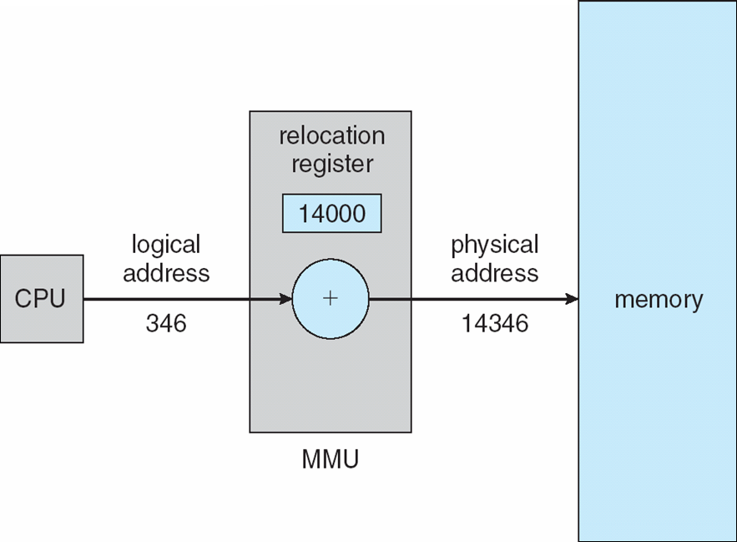
Dynamic relocation using a relocation register
Routine is not loaded until it is called
Better memory-space utilization; unused routine is never loaded
All routines kept on disk in relocatable load format
Useful when large amounts of code are needed to handle infrequently occurring cases
No special support from the operating system is required
Implemented through program design
OS can help by providing libraries to implement dynamic loading

Slide 4
Dynamic Linking
Static linking – system libraries and program code combined by the loader into the binary program image
Dynamic linking –linking postponed until execution time
Small piece of code, stub, used to locate the appropriate memory-resident library routine
Stub replaces itself with the address of the routine, and executes the routine
Operating system checks if routine is in processes’ memory address
If not in address space, add to address space
Dynamic linking is particularly useful for libraries
System also known as shared libraries
Consider applicability to patching system libraries
Versioning may be needed

Slide 5
Swapping
A process can be swapped temporarily out of memory to a backing store, and then brought back into memory for continued execution
Total physical memory space of processes can exceed physical memory
Backing store – fast disk large enough to accommodate copies of all memory images for all users; must provide direct access to these memory images
Roll out, roll in – swapping variant used for priority-based scheduling algorithms; lower-priority process is swapped out so higher-priority process can be loaded and executed
Major part of swap time is transfer time; total transfer time is directly proportional to the amount of memory swapped
System maintains a ready queue of ready-to-run processes which have memory images on disk

Slide 6
Swapping (Cont.)
Does the swapped out process need to swap back in to same physical addresses?
Depends on address binding method
Plus consider pending I/O to / from process memory space
Modified versions of swapping are found on many systems (i.e., UNIX, Linux, and Windows)
Swapping normally disabled
Started if more than threshold amount of memory allocated
Disabled again once memory demand reduced below threshold

Slide 7
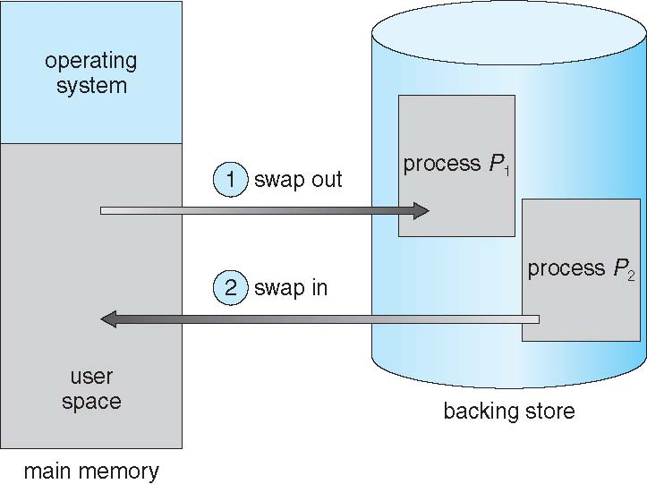
Schematic View of Swapping

Slide 8
Paging
Physical address space of a process can be noncontiguous; process is allocated physical memory whenever the latter is available
Avoids external fragmentation
Avoids problem of varying sized memory chunks
Divide physical memory into fixed-sized blocks called frames
Size is power of 2, between 512 bytes and 16 Mbytes
Divide logical memory into blocks of same size called pages
Keep track of all free frames
To run a program of size N pages, need to find N free frames and load program
Set up a page table to translate logical to physical addresses
Backing store likewise split into pages
Still have Internal fragmentation

Slide 9
Address Translation Scheme
Address generated by CPU is divided into:
Page number (p) – used as an index into a page table which contains base address of each page in physical memory
Page offset (d) – combined with base address to define the physical memory address that is sent to the memory unit
For given logical address space 2^{m} and page size 2^{n}

Slide 10
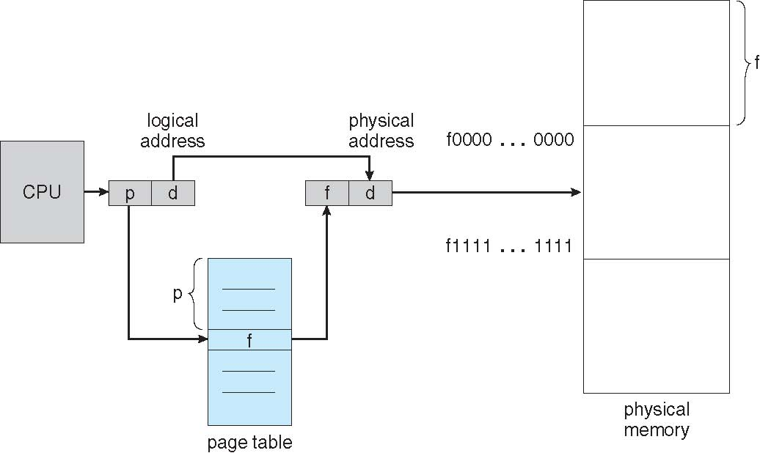
Paging Hardware

Slide 11
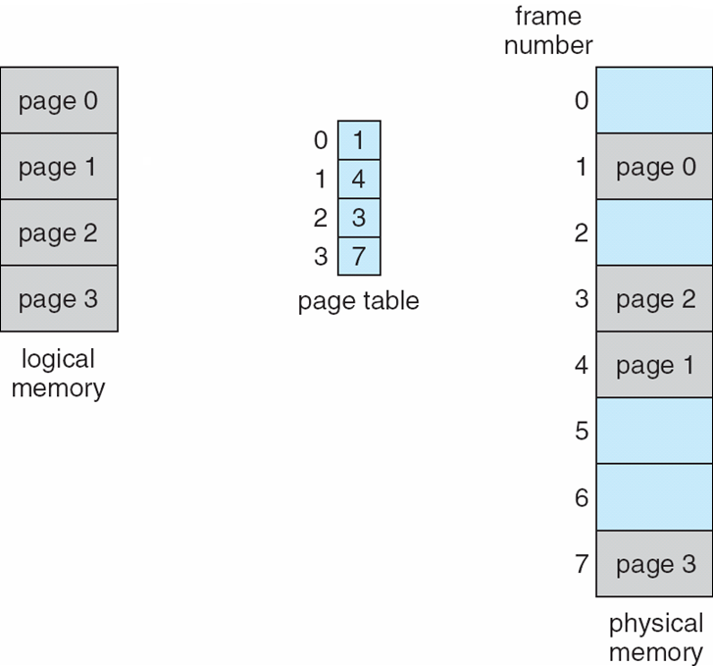
Paging Model of Logical and Physical Memory

Slide 12
Paging (Cont.)
Calculating internal fragmentation
Page size = 2,048 bytes
Process size = 72,766 bytes
35 pages + 1,086 bytes
Internal fragmentation of 2,048 - 1,086 = 962 bytes
Worst case fragmentation = 1 frame – 1 byte
On average fragmentation = 1 / 2 frame size
So small frame sizes desirable?
But each page table entry takes memory to track
Page sizes growing over time
Solaris supports two page sizes – 8 KB and 4 MB
Process view and physical memory now very different
By implementation process can only access its own memory

Slide 13
Implementation of Page Table
Page table is kept in main memory
Page-table base register (PTBR) points to the page table
Page-table length register (PTLR) indicates size of the page table
In this scheme every data/instruction access requires two memory accesses
One for the page table and one for the data / instruction
The two memory access problem can be solved by the use of a special fast-lookup hardware cache called associative memory or translation look-aside buffers (TLBs)

Slide 14
Implementation of Page Table (Cont.)
Some TLBs store address-space identifiers (ASIDs) in each TLB entry – uniquely identifies each process to provide address-space protection for that process
Otherwise need to flush at every context switch
TLBs typically small (64 to 1,024 entries)
On a TLB miss, value is loaded into the TLB for faster access next time
Replacement policies must be considered
Some entries can be wired down for permanent fast access

Slide 15
Associative Memory
Associative memory – parallel search
Address translation (p, d)
If p is in associative register, get frame # out
Otherwise get frame # from page table in memory

Slide 16
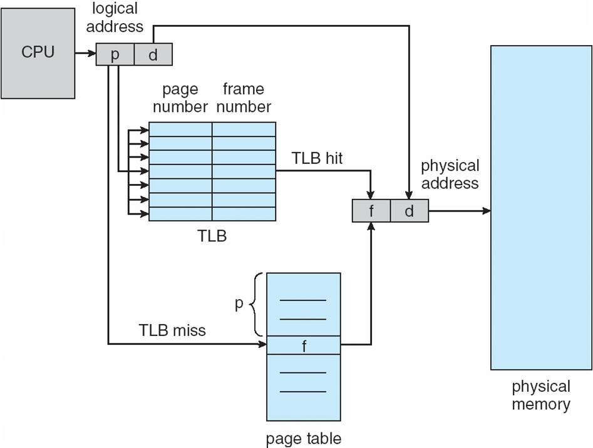
Paging Hardware With TLB

